Slide 1
Drexel 2020 Micromouse Algorithm

Slide 2
Algorithm Overview
State Based
State 0: Explore path to goal
State 1: Try to find unexplored path from goal to start
State 2: Take optimal path to goal
Main Loop:
  Map surroundings
  Find path
  Move

Slide 3
Exploration
Initially, the robot tries to find a path to the goal
Once the goal is reached, the robot tries to find an unexplored path back to the start
Paths are found using A* with a modified heuristic

Slide 4
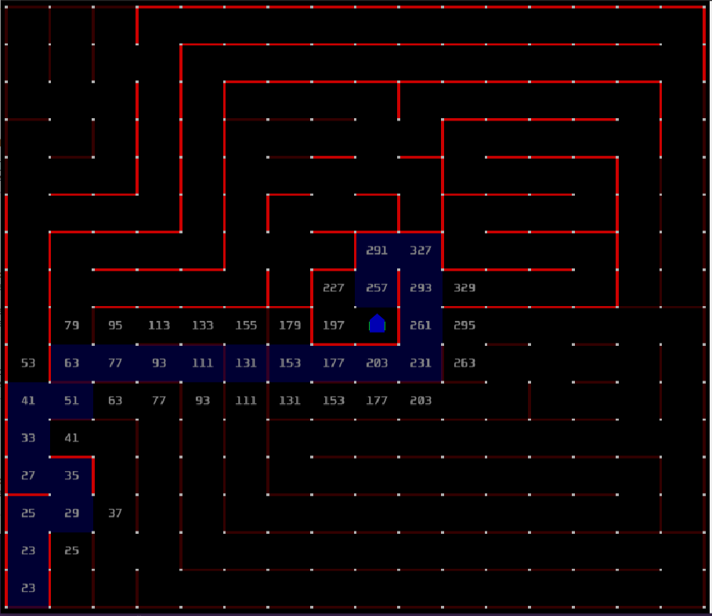
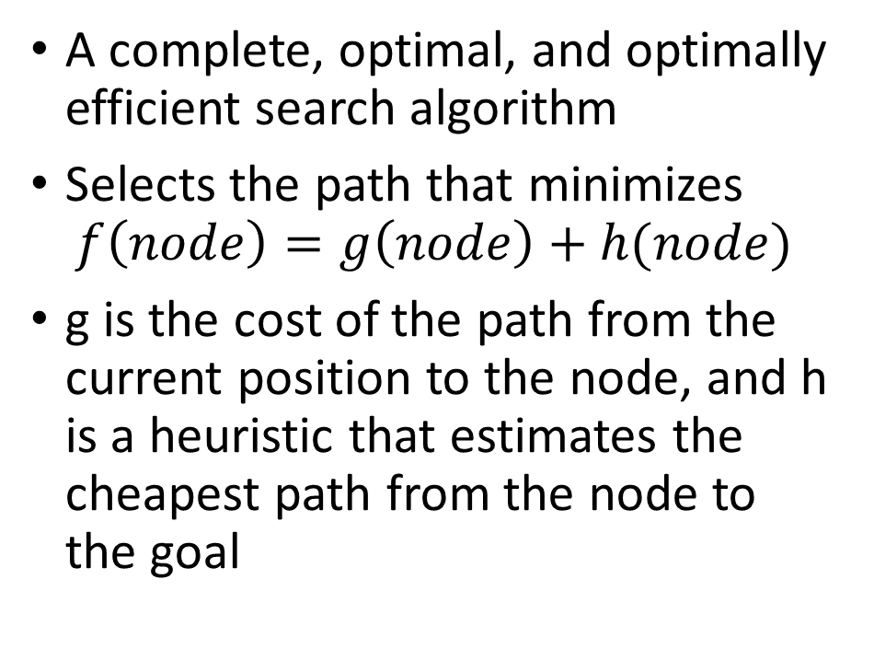
A* (A-star)
A complete, optimal, and optimally efficient search algorithm
Selects the path that minimizes
$$f\left(node\right)=g\left(node\right)+h(node)$$
g is the cost of the path from the current position to the node, and h is a heuristic that estimates the cheapest path from the node to the goal

Slide 5
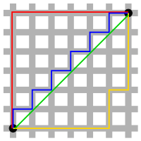
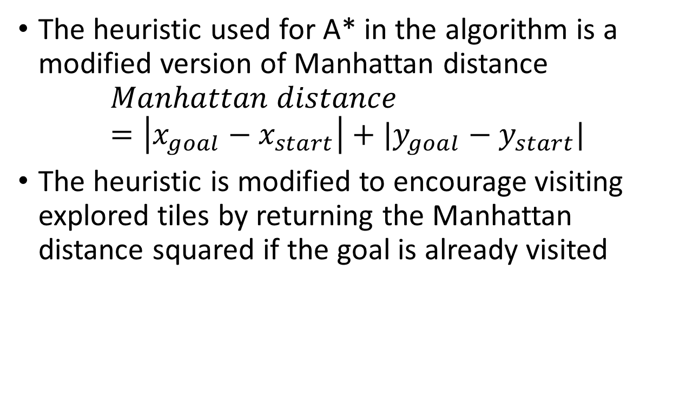
A* (A-star) cont.
The heuristic used for A* in the algorithm is a modified version of Manhattan distance
$$Manhattan distance=\left|x_{goal}−x_{start}\right|+|y_{goal}−y_{start}|$$
The heuristic is modified to encourage visiting explored tiles by returning the Manhattan distance squared if the goal is already visited
The Manhattan distance for the red, yellow, and blue paths is the same: 12. The green line is the Euclidian distance

Slide 6
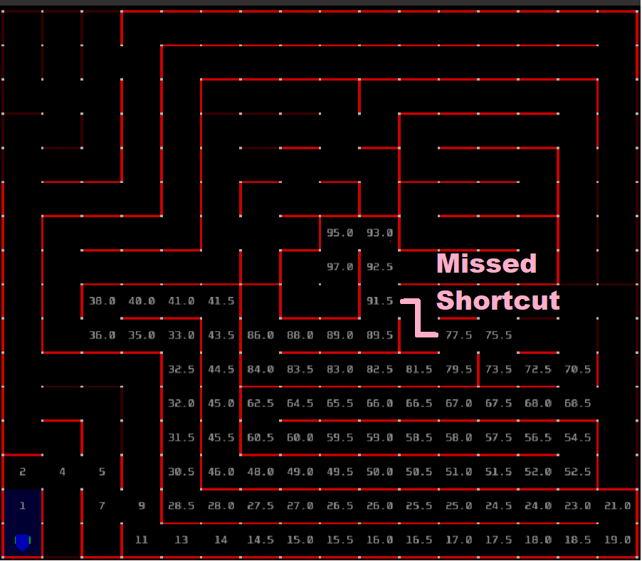
Best path without shortcut exploration:
Final score: 137.15

Slide 7
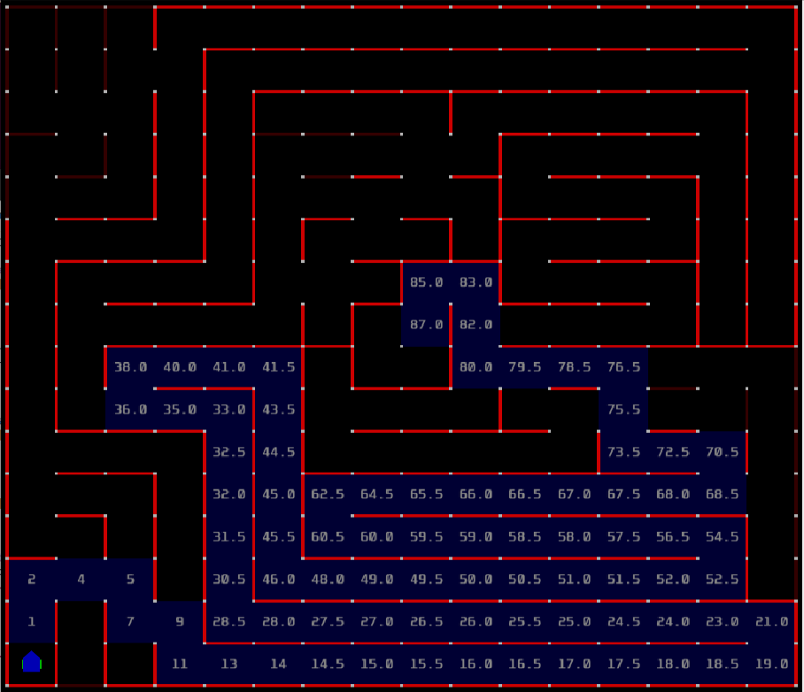
Best path with shortcut exploration:
Final score: 147.05 – Worse!

Slide 8
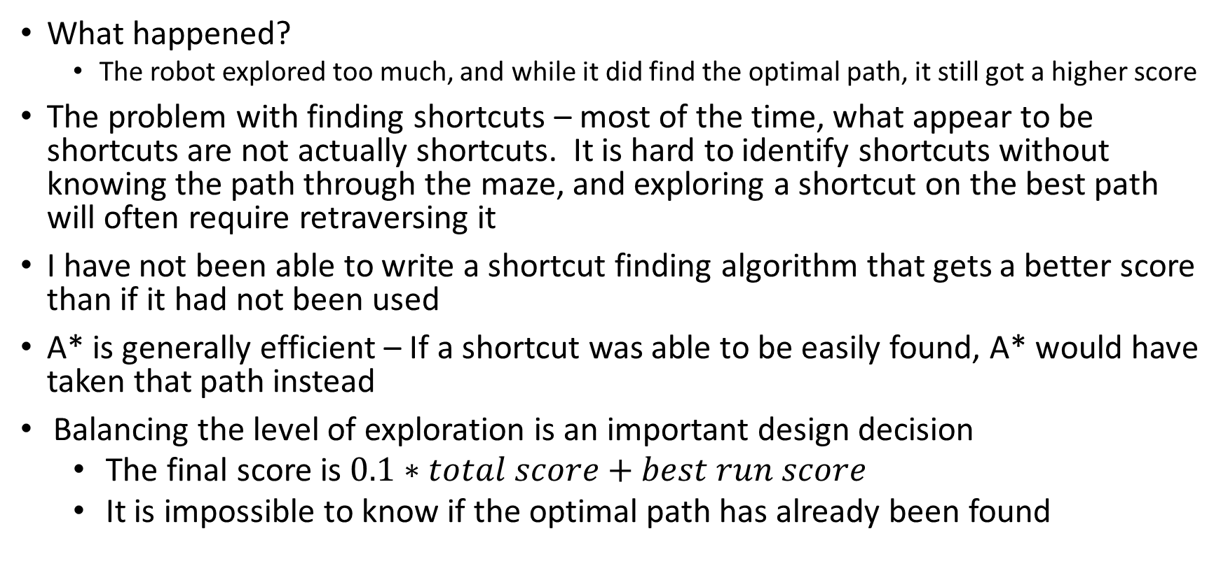
Finding shortcuts
What happened?
  The robot explored too much, and while it did find the optimal path, it still got a higher score
The problem with finding shortcuts – most of the time, what appear to be shortcuts are not actually shortcuts. It is hard to identify shortcuts without knowing the path through the maze, and exploring a shortcut on the best path will often require retraversing it
I have not been able to write a shortcut finding algorithm that gets a better score than if it had not been used
A* is generally efficient – If a shortcut was able to be easily found, A* would have taken that path instead
Balancing the level of exploration is an important design decision
  The final score is $0.1∗total score+best run score$
  It is impossible to know if the optimal path has already been found

Slide 9
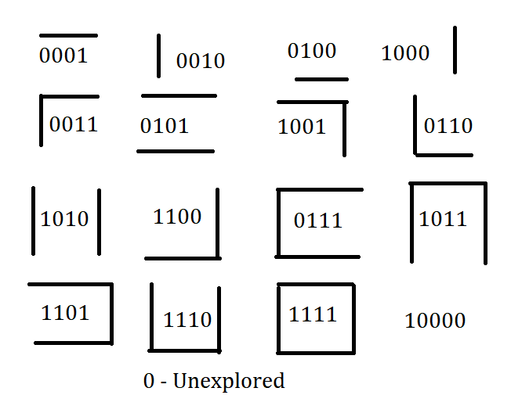
Saving the maze in memory
The maze was stored as combinations of binary digits. This allows for very fast and simple checking if a neighbor is accessible

Slide 10
Choosing the best path
Once the robot has explored, the best path to the goal must be chosen
Since the Manhattan distance heuristic only considers distance, not effective distance + turns (score), it sometimes overestimates the actual cost to the goal, so A* is not guaranteed to return the best path
A heuristic that incorporates score could be developed, but this itself would require calculating the optimal path between the start and goal, which is what we are trying to use A* to do
Therefore, a BFS (breadth-first search) is used to find all paths

Slide 11
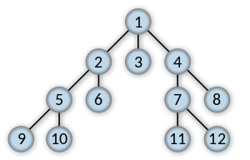
Choosing the best path cont.
Once the BFS finds all paths, the one with the lowest score is chosen
The robot then takes this path to the destination
Order of expanding nodes in BFS
This is guaranteed to find the optimal path using only visited tiles. In the case that tiles which are part of the maze’s optimal path are not explored, a suboptimal path is followed

